Slide 1
Team 5
Project Midterm Progress Report
Ruoning Ren/Huangshuai Shi/Jiahui Xi
05/17/2022

Slide 2
Progress Overview
What we did
Adapted HW codes for the card spring simulation project
Implemented the DEB (discrete elastic beam) and DER (discrete elastic rod) method
Completed simulation of Flex-and-Release motion

Slide 3
Simulation Approaches
DEB - Discrete Elastic Beam
Assumptions:
Uniform distribution of mass
Uniform distribution of bending force on the top and bottom edges of the card.
Force components are parallel to x-axis and y-axis, no z-axis component

Slide 4
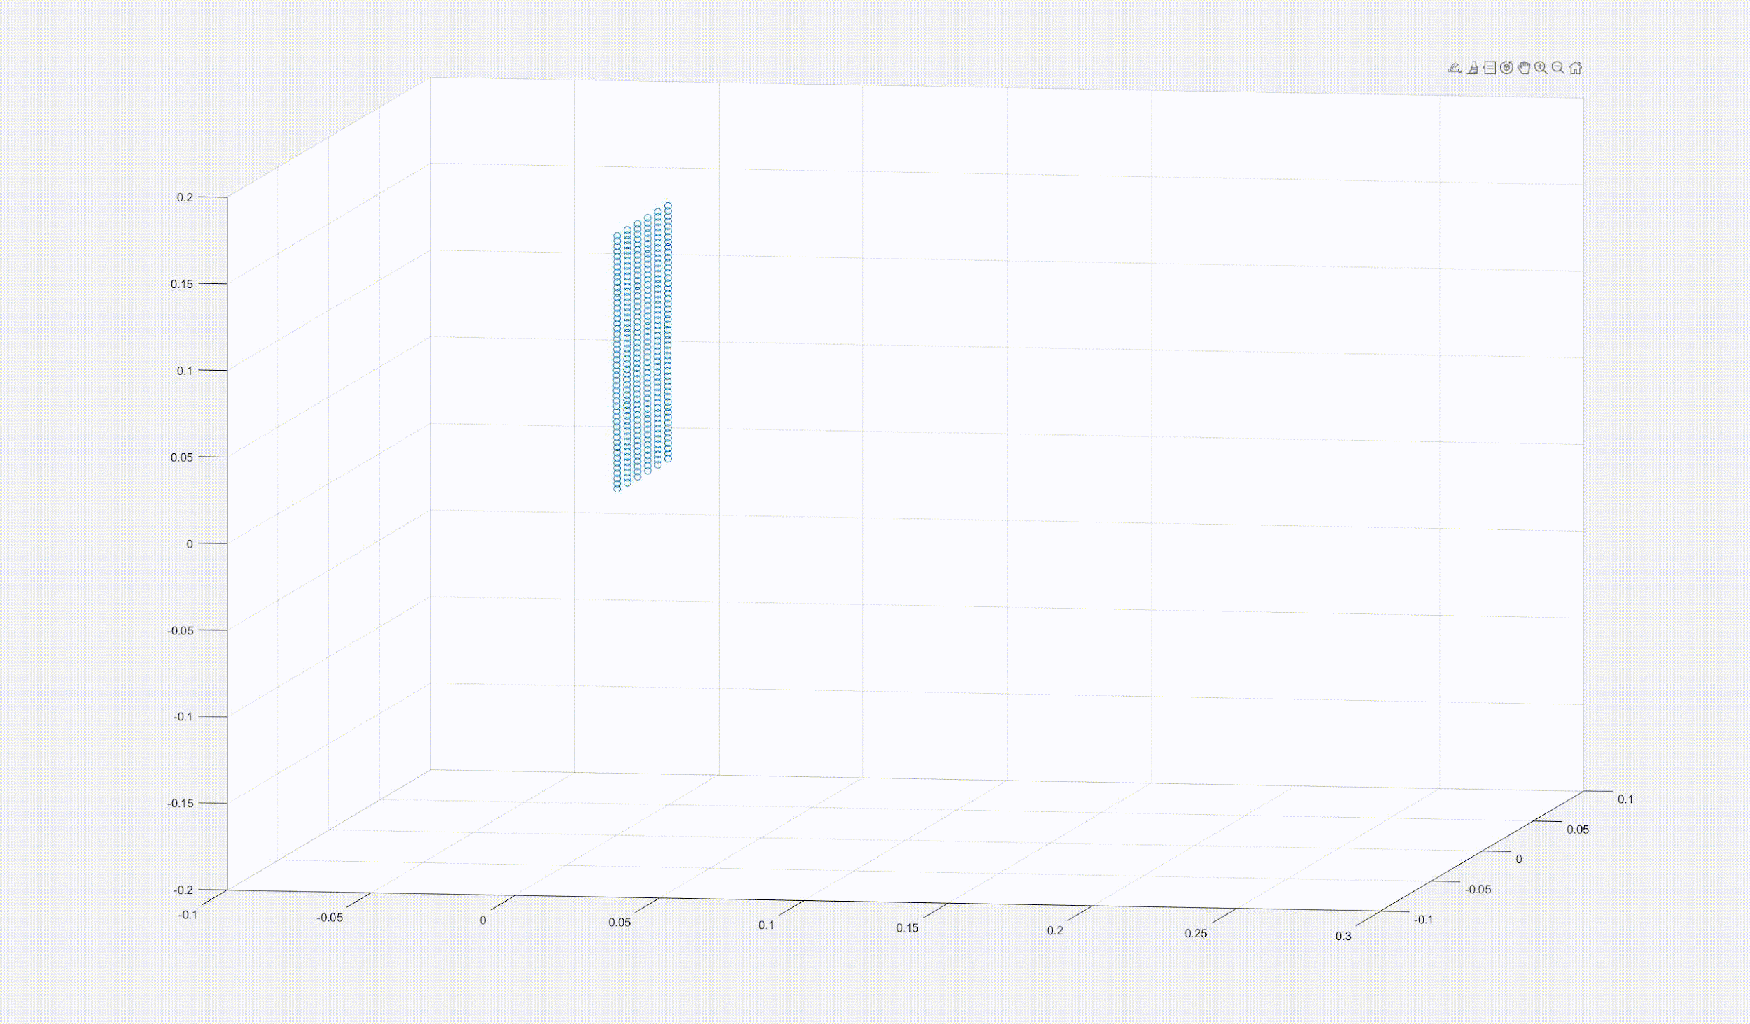
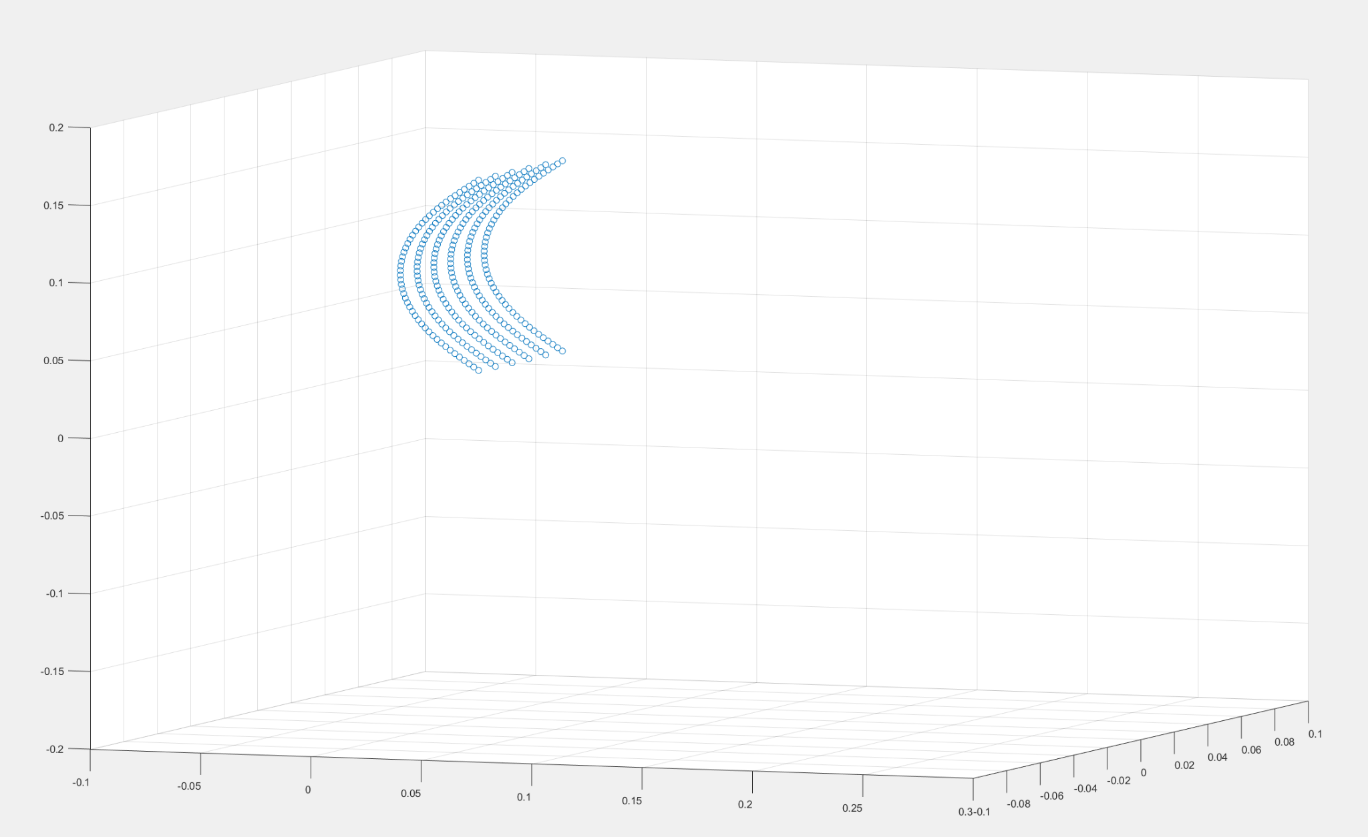

Slide 5
Simulation Approaches
DER - Discrete Elastic Rod
Assumptions:
Uniform distribution of mass
Uniform distribution of bending force on the top and bottom edges of the card.
Force components are parallel to x-axis and y-axis, no z-axis component
改

Slide 6
Phases of simulation
Phase 1:
Bending the card until it reaches a designated equilibrium form
Top node fixed in the x and y directions
Bottom node fixed in the x direction

Slide 7
Phases of simulation
Phase 2: without constraint
Releasing one bent card from phase 1 form (Card is able to oscillate and rebound)
All fixed nodes are released
Phase 2: with constraint
Card oscillates and rebounds against the card behind
Boundary is set -0.003m in x-direction in the same form as bent card

Slide 8
Phases of simulation
Phase 3:
Free oscillation and motion
after leaving from boundary contact
No contact force
No fixed nodes

Slide 9
Methods
Newton Raphson
Implement the Newton Raphson iterative method learned from class
Mass Modification

Slide 10
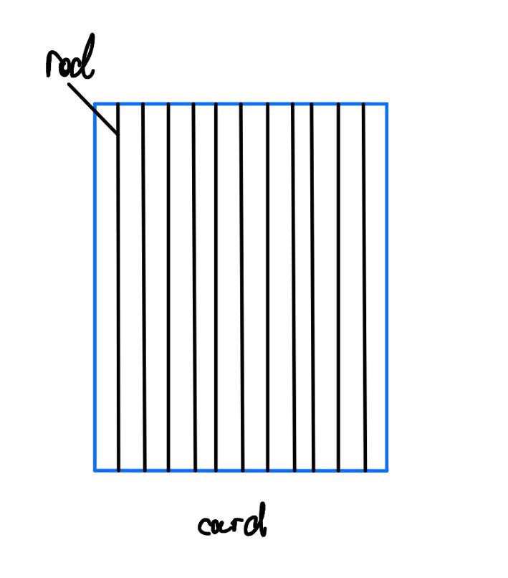
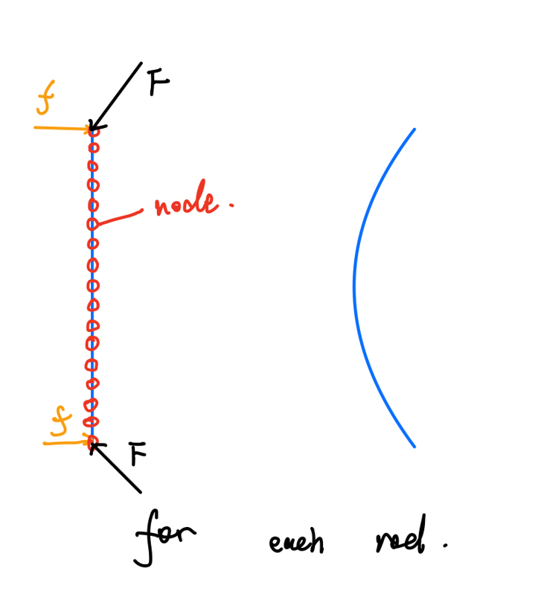
Discrete Elastic Rods
A composition of multiple parallel rods / every rod bears bending force and friction

Slide 11
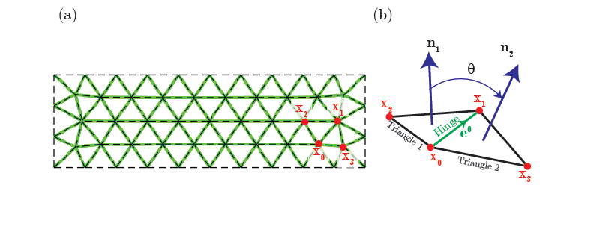

Discrete Elastic Plates/Shells
All edges, except the ones on the boundary of the structure, are hinges. Each hinge is associated with four nodes: x0, x1, x2, and x3. Here x2 and x3 can bend

Slide 12
Deliverables
a. a video clip about discrete elastic rods method with constant load distribution.
b. a video clip about discrete elastic rods method with function controlled load distribution.
c. a video clip about discrete elastic shell method with constant load distribution.

